Slide 1
Results ML charging behaviour 2.0

Slide 2
Split based on users
Overfit on individual features (car type, main office) lower in tree
General conclusions remain valid
Accuracy 74%=>66%: less reliable than fist thought

Slide 3
Office hours
Accuracy 66%=>75% : decisive for outcome
Most important feature remains ‘’has home charger’’

Slide 4
Office hours
People without home charger
During office hours
2x more in office than public
Before 2021 3x more office than public
Since 2021 more public
Small charges & small battery size office
People with home charger
Within working hours 22% office 13% public
Outside working hours 29% public

Slide 5
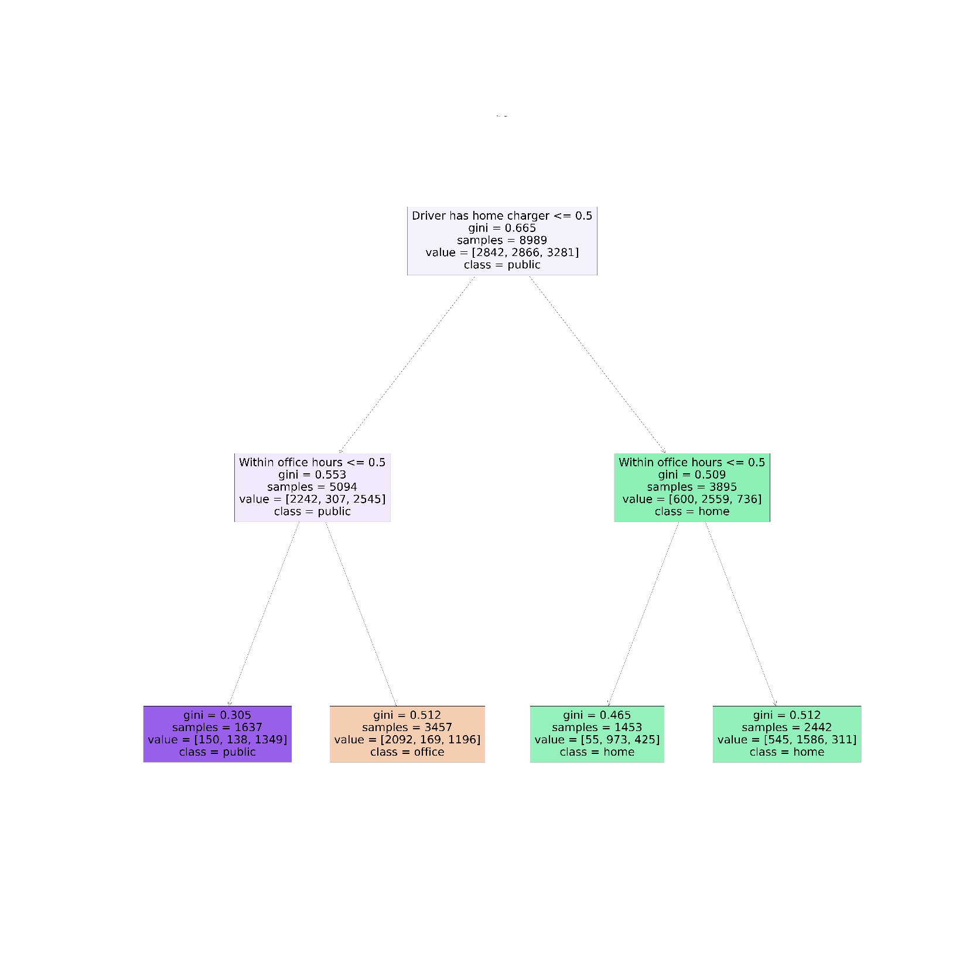

Slide 6
Before or afternoon
People without home charger:
Little more public in afternoon
People with home charger:
Mostly after noon => charging during night
Before noon (start time) more office

Slide 7
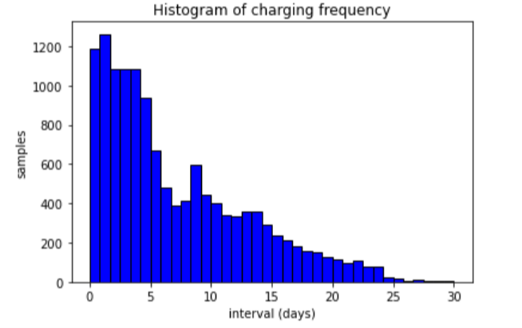
Frequency of charging: global

Slide 8
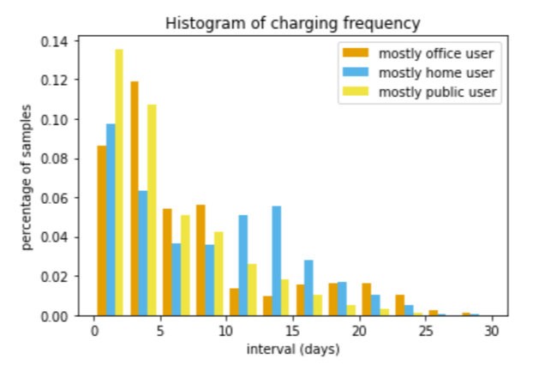
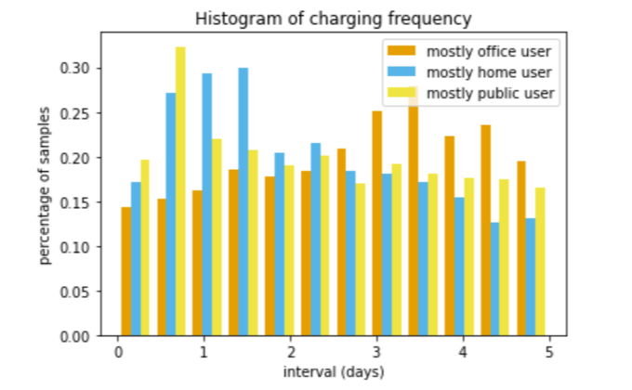
Frequency of charging: user types

Slide 9
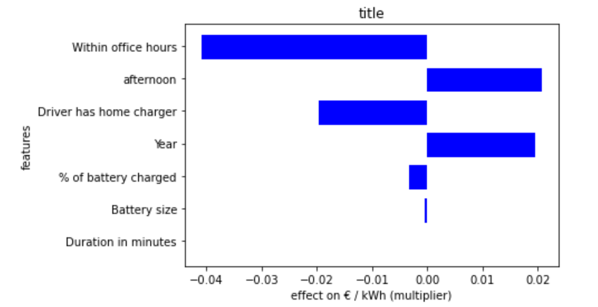
Effect of features on costprice in linear regression

